Slide 1
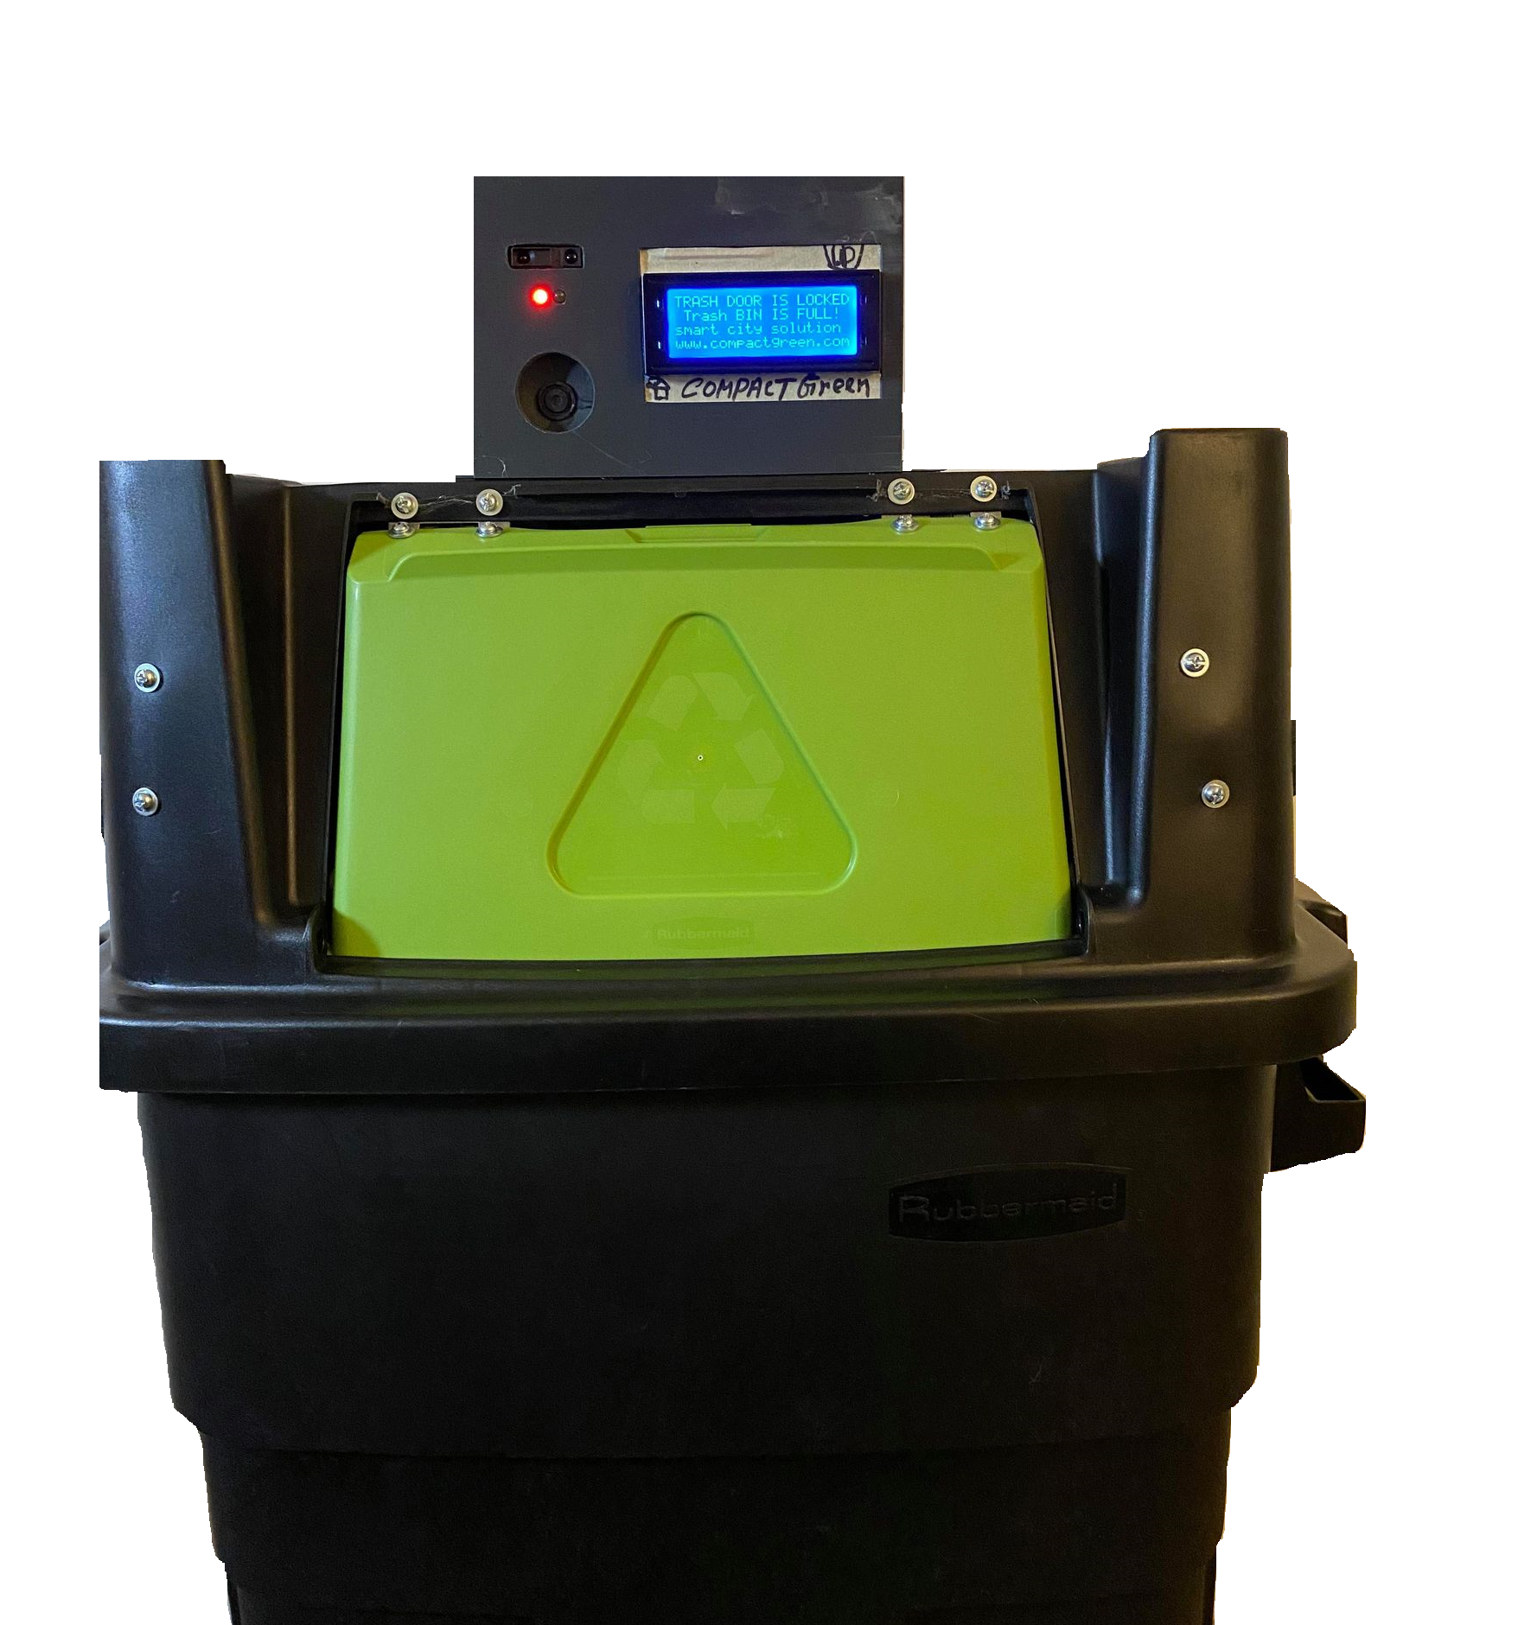
Compact Green, LLC.
Katherine Perry
Brandon Young
Dang Nguyen
Muhib Mahmud
Aqib Mahmud

Slide 2
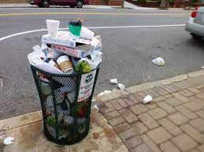
The Regular Old Trash Can
Consumer Complaints:
Attracts bugs
Lingering smells
No way of communicating whether or not it is full
City Complaints:
Cost cities an extra million dollars a year
Time wasted by either empty trash cans or overflowing trash cans
Environmental Issues:
Increased emissions
Increased pollution

Slide 3
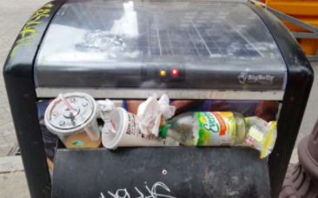
Competitors
Big Belly Smart Solutions for Cities
Incorporation of revolutionized trash cans with “smart features”:
Providing sensor level trash indications
Trash compaction
Printed ads & designs on the cans
Handle on the opening to access trash bin
Locking system
Plan for Improvements:
Smoke detecting sensor
IR proximity sensor
Improved locking system

Slide 4
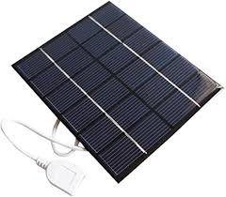
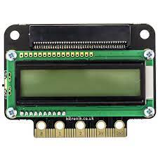
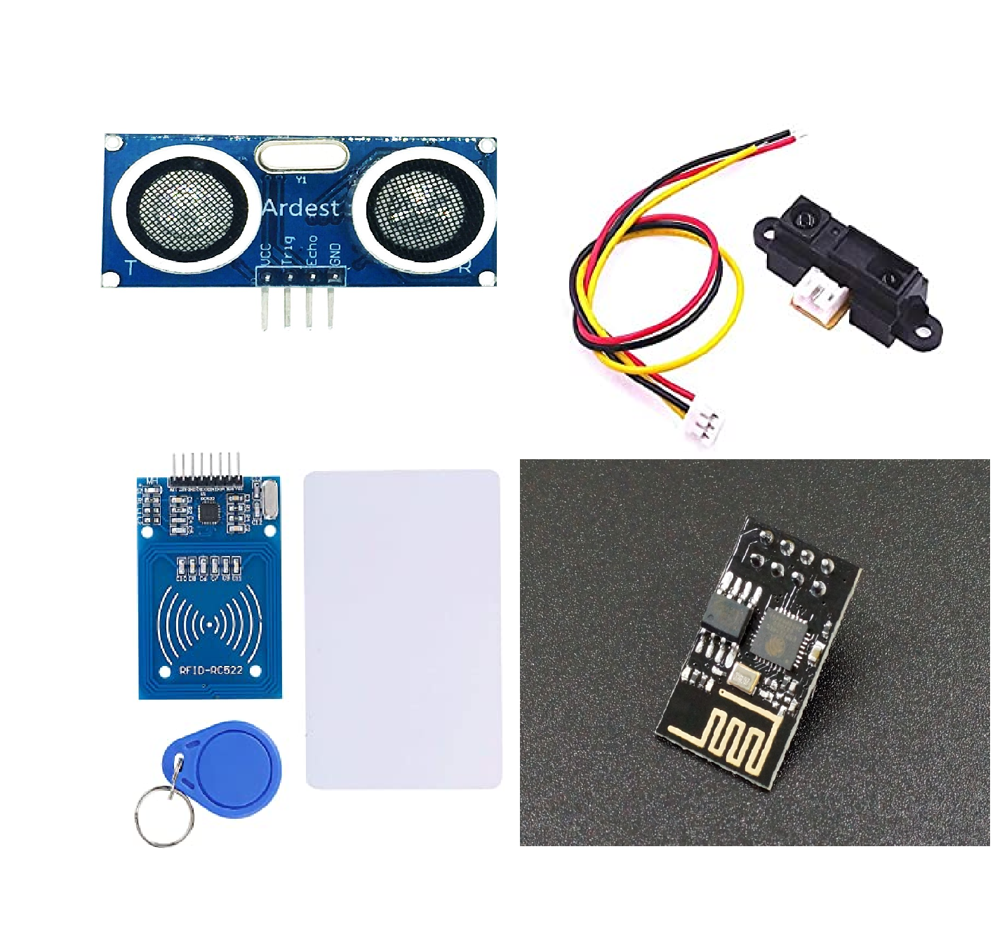
Our Take on the Problem
A solar powered trash can
IOT compatibility
Sensors to sense trash level
IR proximity sensor
LCD Screen & LED
RFID LOCK
No handles (Swing door)

Slide 5
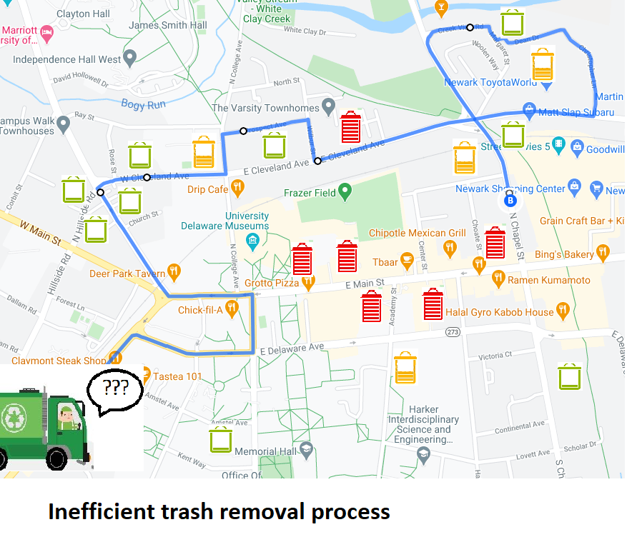
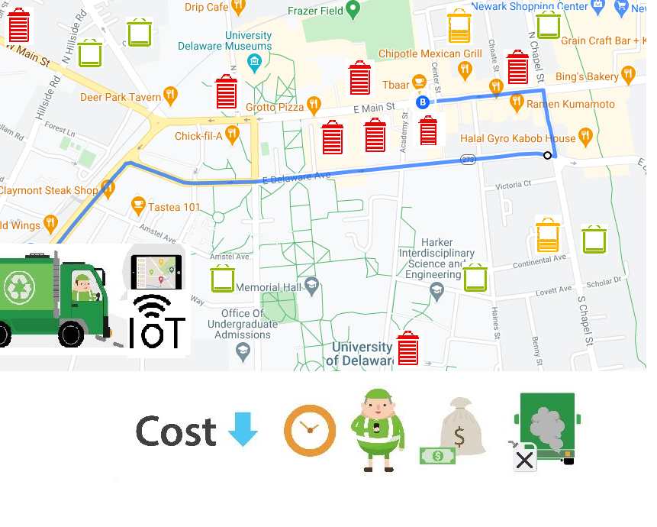
Collecting Data from Cloud
Before Data Collection:
Each trash can will share its’ data to the cloud
Trash routes will be more effective and efficient
End goal:
Less frustration among consumers
Less time consuming Jobs
Lowers emissions of garbage trucks
Faster collection time
More funding for other city programs
After Data Collection:

Slide 6
Cost structure, revenue model & sales channel
Product cost (per unit) :
Initial prototype cost: $220
Final product manufacturing cost: $800
Current Bigbelly cost per unit: $4100
Other major cost (% of gross income) :
Marketing & promotion: 3%
Storage, shipping: 7%
Operating expense : 50%
Other costs (variable): 5-12 %
Revenue Model: Direct Sales
Wholesale price point: $3000 - $3500 (depends on quantity)
Target gross profit: 70% (at least)
Target net profit margin: 20% (at least)
Sales Channel:
Large city trash committees
Board of U.S commercial malls
School of district board

Slide 7
What we need from you?
Contacts to big city waste committees, and environmental / material science researchers
Advice on Upgrades
Compactor
Larger display for digital advertising
Different sizing options
Future app development for consumers/ waste companies
How much money do we need to further our product?
In total: $750,000 for starting up for 20% equity
Manufacturing the ideal prototype
Compactor: $10,000 ( $3000 per compactor device)
Large E-ink Display: $2000 (Profit 2k-7k per week)
App development: $150,000

Slide 8

Questions?
Thank you for Watching!
Prototype Demo

Slide 9
Market & Technical Information
Market Studies:
Current Market size: 8.11 million North America & 4 billion global
Expected growth by 2025: 12.32 million North America & 7.87 billion global
Key Trend: Rise in industrialization & IOT usage
Growth strategy: Product launch
Competition Analysis:
Major player: No Dominant player found
Others: Bigbelly Solar, Ecube, Enevo, Compology, SmartBin, Urbiotica (estimated 38 total)
Bigbelly total revenue $89 Million according to latest 10k report
Entry to Market: Easy (Less saturation & Huge market size)
Entry Factor: Need $750,000+ investments
Technical Details (Initial prototype):
Trash capacity: 30 gal without lid
Size: 15.5 in * 36.5 in * 24 in
Battery Capacity : 5000 maH
Solar power rating: 6V 1W
Technical Features (prototype):
Trash full Detection & locking
Smoke detection
RFID unlock
Solar power management module
IOT compatibility

Slide 10
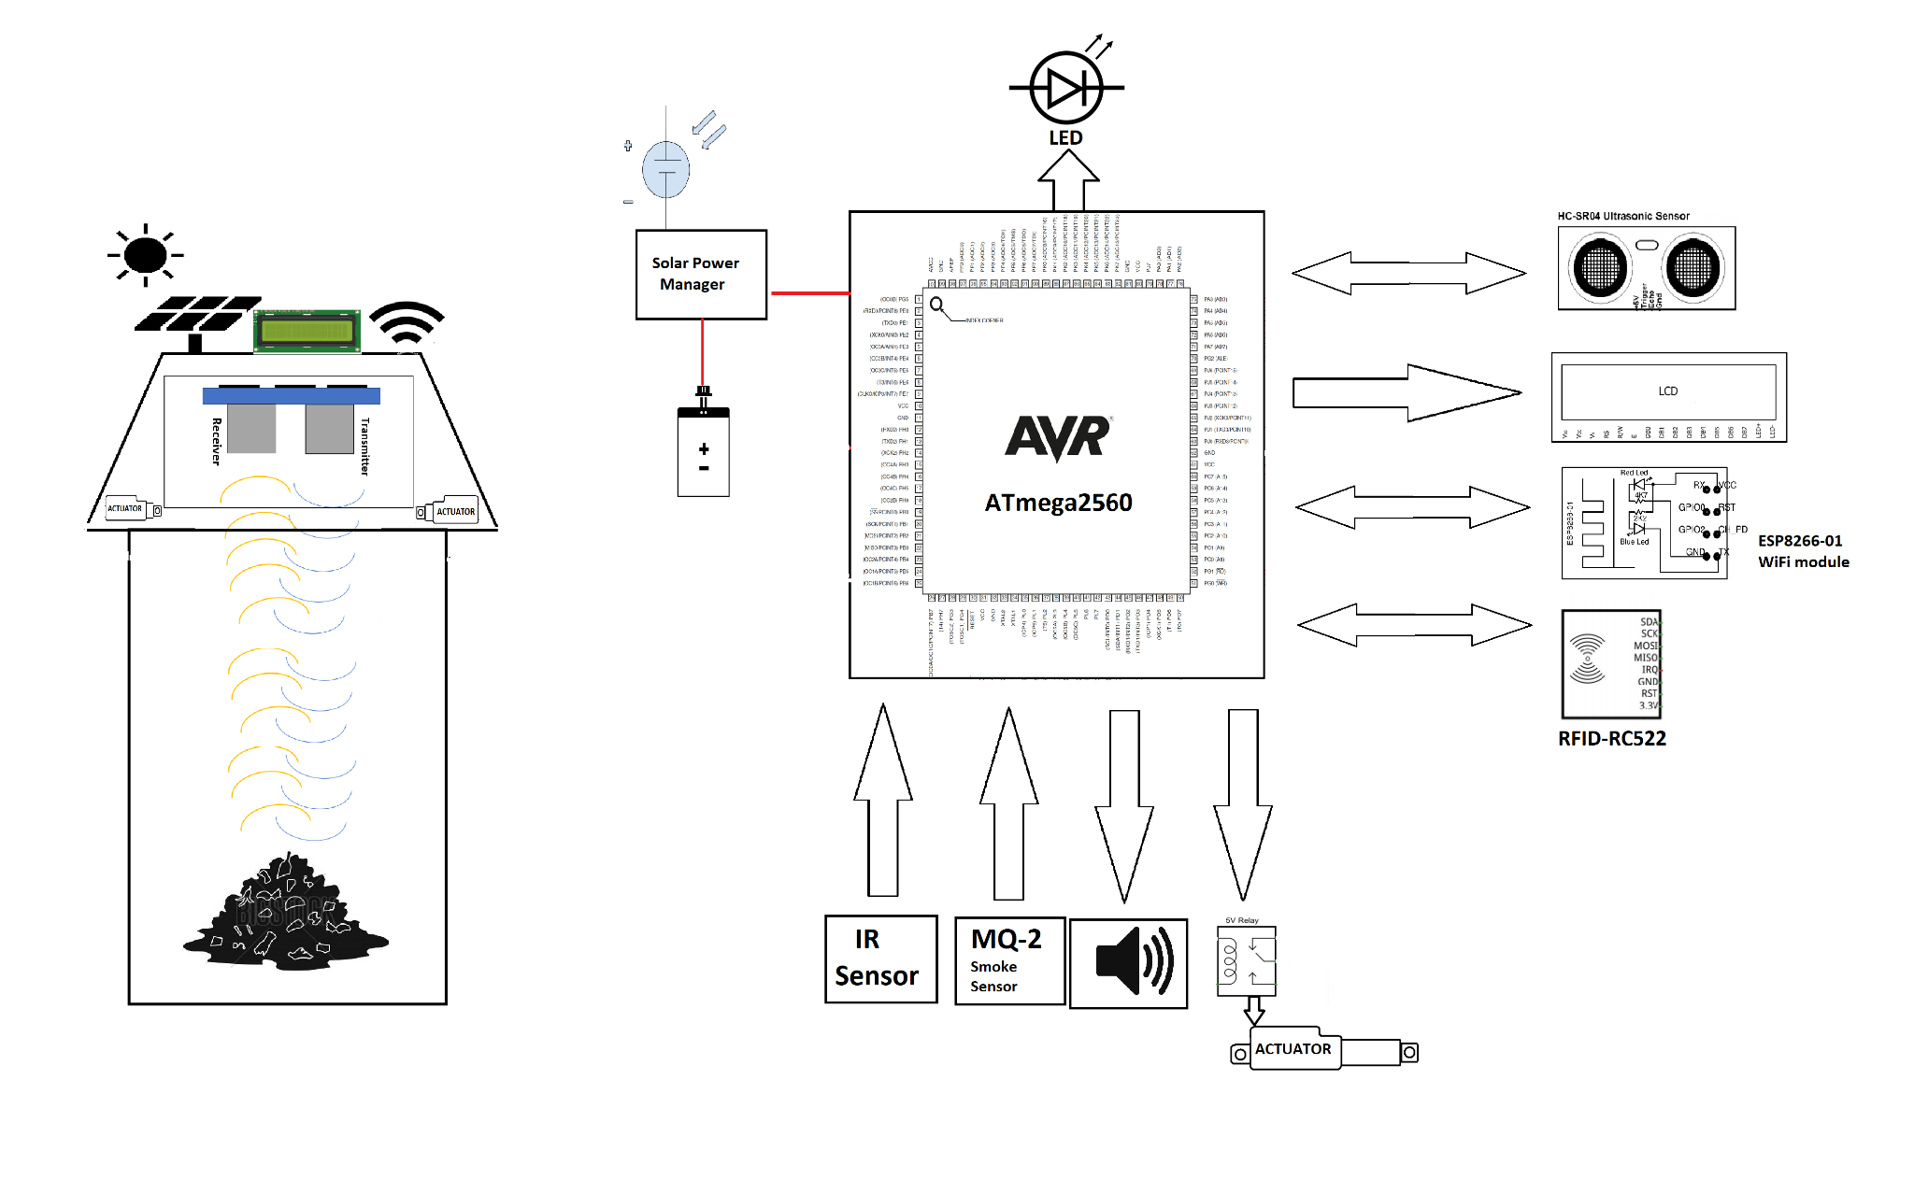
System Block Diagram

Slide 11
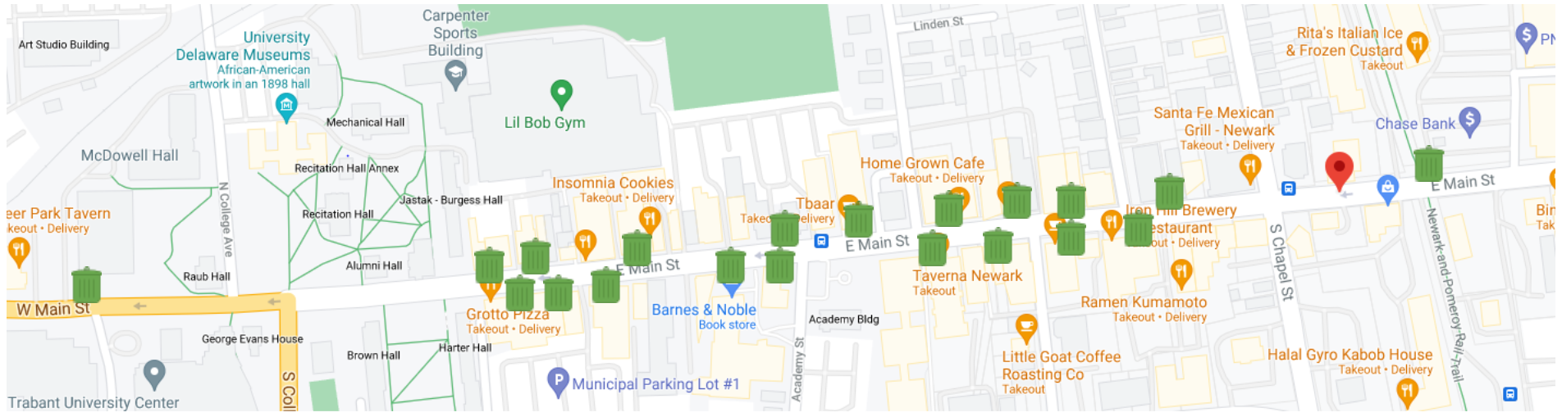
Big Belly on E. Main Street
Each mini trash can represents two Big Belly Smart Compactors
There are 44 Big Belly Compactors on E. Main Street in total along a ¾ of a mile distance (two icons are not present)

